Slide 1
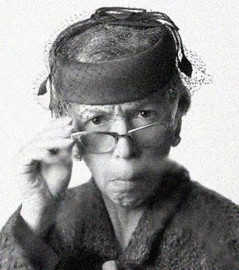
Mrs. Eyeville Reed
I expect students to read the prompt carefully! The prompt is jammed packed with important information!

Slide 2
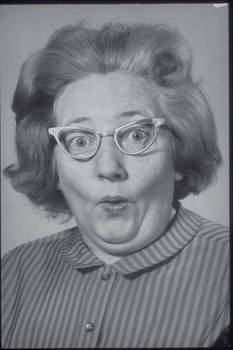
Mrs. Katchie Label
I am surprised when I read a unique and catchy title! That makes a great first impression of a student’s writing! ☺

Slide 3
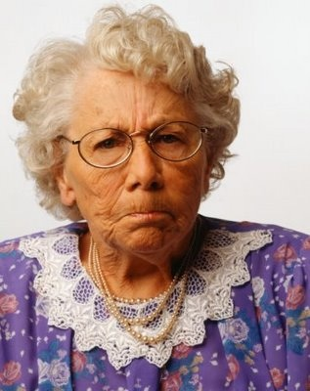
Mrs. Osie Dee
I expect students to organize their writing!
Introduction Body
Conclusion

Slide 4
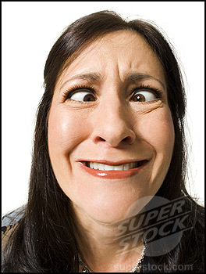
Mrs. Eyeam Baffled
I am confused when students don’t include details and description in their writing.

Slide 5
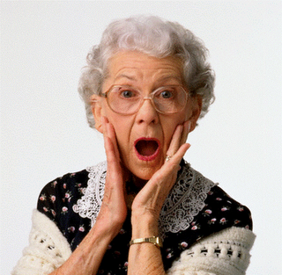
Mrs. Actshun Verb
I can’t believe it when a student uses great word choice! It makes their writing so much better…especially if the student uses lots of action verbs!!

Slide 6
Mrs. Loveda Voyce
I love to see voice in the student’s writing! I always score the writing higher if the student makes me feel something!

Slide 7
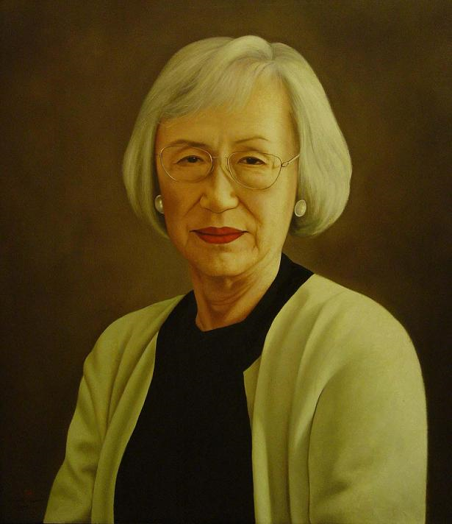
Mrs. Dontbie Lazy
In my proper opinion, texting lingo and other abbreviations should be outlawed! I expect students to use only proper English in their writing.

Slide 8
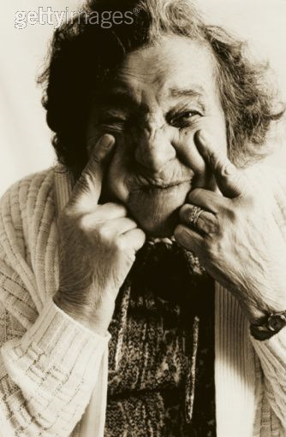
Mrs. Icee Effort
I expect to see effort! I expect students
to write
at least two+ pages!!!

Slide 9
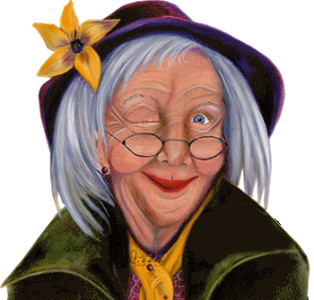
Mrs. Konfidance Inyew
I am excited to read your writing! I know that you will do your best!

